Slide 1
Version Date: 17Aug2022
Mucositis Care Pathway
Prevention
Prevention Options
Promote good oral hygiene including brushing at least twice daily and gentle flossing
Consult dentistry for evaluation as soon as possible after diagnosis
Determine treatment-related risk for mucositis
For patients at high risk, consider using:
Cryotherapy
Photobiomodulation
Use cryotherapy for patients receiving melphalan or 5-fluorouracil
Consider using cryotherapy if associated chemotherapy given by short IV infusion and co-operative patient
Use intraoral photobiomodulation therapy in patients undergoing autologous or allogeneic HSCT and for patients who will receive radiotherapy for head and neck carcinoma
Consider using intraoral photobiomodulation therapy for patients who will receive radiotherapy for head and neck cancers other than carcinoma
Prevention
Do not routinely use palifermin
Do not routinely use granulocyte colony stimulating factors for mucositis prevention
Assessment
Evaluate oral mucous membranes routinely
Assess routinely using SSPedi
Assessment
Mild Bother
(SSPedi score = a little)
Moderate Bother
(SSPedi score = medium)
Severe Bother
(SSPedi score = a lot or extremely)
Allocate resources based on severity of bother and according to the preferences and capabilities of the patient
Treatment and Resources
Optimize oral hygiene as tolerated
Treatment
Optimize nutrition including the use of enteral feeds or parenteral nutrition
Treatment Options*
Consult clinical nutrition services
Follow pain care pathway

Slide 2
Version Date: 17Aug2022
Mucositis Care Pathway
Cryotherapy Information
What is cryotherapy?
Cryotherapy is the process of maintaining ice-cold liquids (e.g. ice cubes, ice chips, ice water, popsicles, freezies or ice pops) in the mouth during infusion of mucositis-associated chemotherapy. It is effective at preventing mucositis.
To be feasible, chemotherapy infusion must be 60 minutes or less.
Ice cubes, ice chips or ice water
Popsicles, freezies or ice pops
Short infusion (60 minutes or less) chemotherapies associated with mucositis:
Amsacrine
Bleomycin
Dactinomycin
Fluorouracil (5-FU)
Idarubicin
Melphalan
Mitoxantrone
*This is not an exhaustive list.

Slide 3
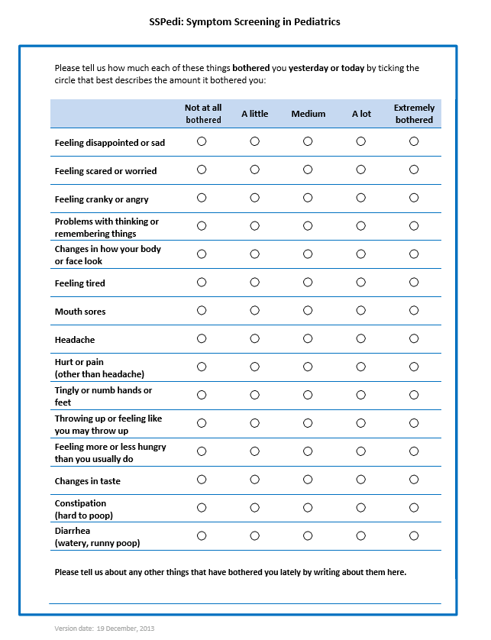
Version Date: 6Jul2021
Care Pathway

