Slide 1
Version Date: 6Jul2021
Depression Care Pathway
Prevention
Prevention
Promote routine physical activity
Inform families about support groups and
encourage participation
Assessment
Assess for self-harm and suicidal ideation
If present, consult urgently
Follow institutional standards
Assess routinely using SSPedi
Assessment
Mild Bother
(SSPedi score = a little)
Moderate Bother
(SSPedi score = medium)
Severe Bother
(SSPedi score = a lot or extremely)
Allocate resources based on severity of bother and according to the preferences and capabilities of the patient
Treatment and Resources
Consult mental health specialist early
Consult psychiatry, psychology or social work
When an antidepressant is initiated, monitor for self-harm, suicidal ideation or hostility
If present, consult urgently
Follow institutional standards
Consult psychiatry, psychology, social work, art therapy, chaplaincy, child life services, music therapy or recreational therapy Encourage peer support groups
Offer patients the opportunity to express their feelings regarding their cancer diagnosis
Treatment
Address anxiety if present
Optimize sleep hygiene
Increase physical activity
Consult physiotherapy, occupational therapy or child life services
Optimize nutrition
Consult clinical nutrition services

Slide 2
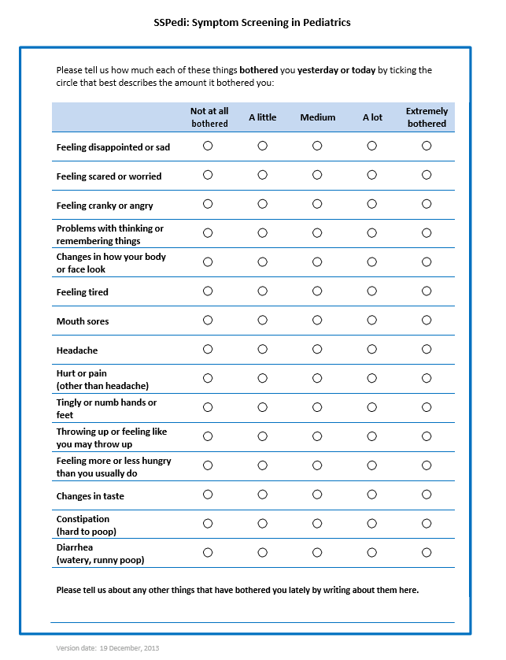
Version Date: 6Jul2021
Care Pathway

Slide 3
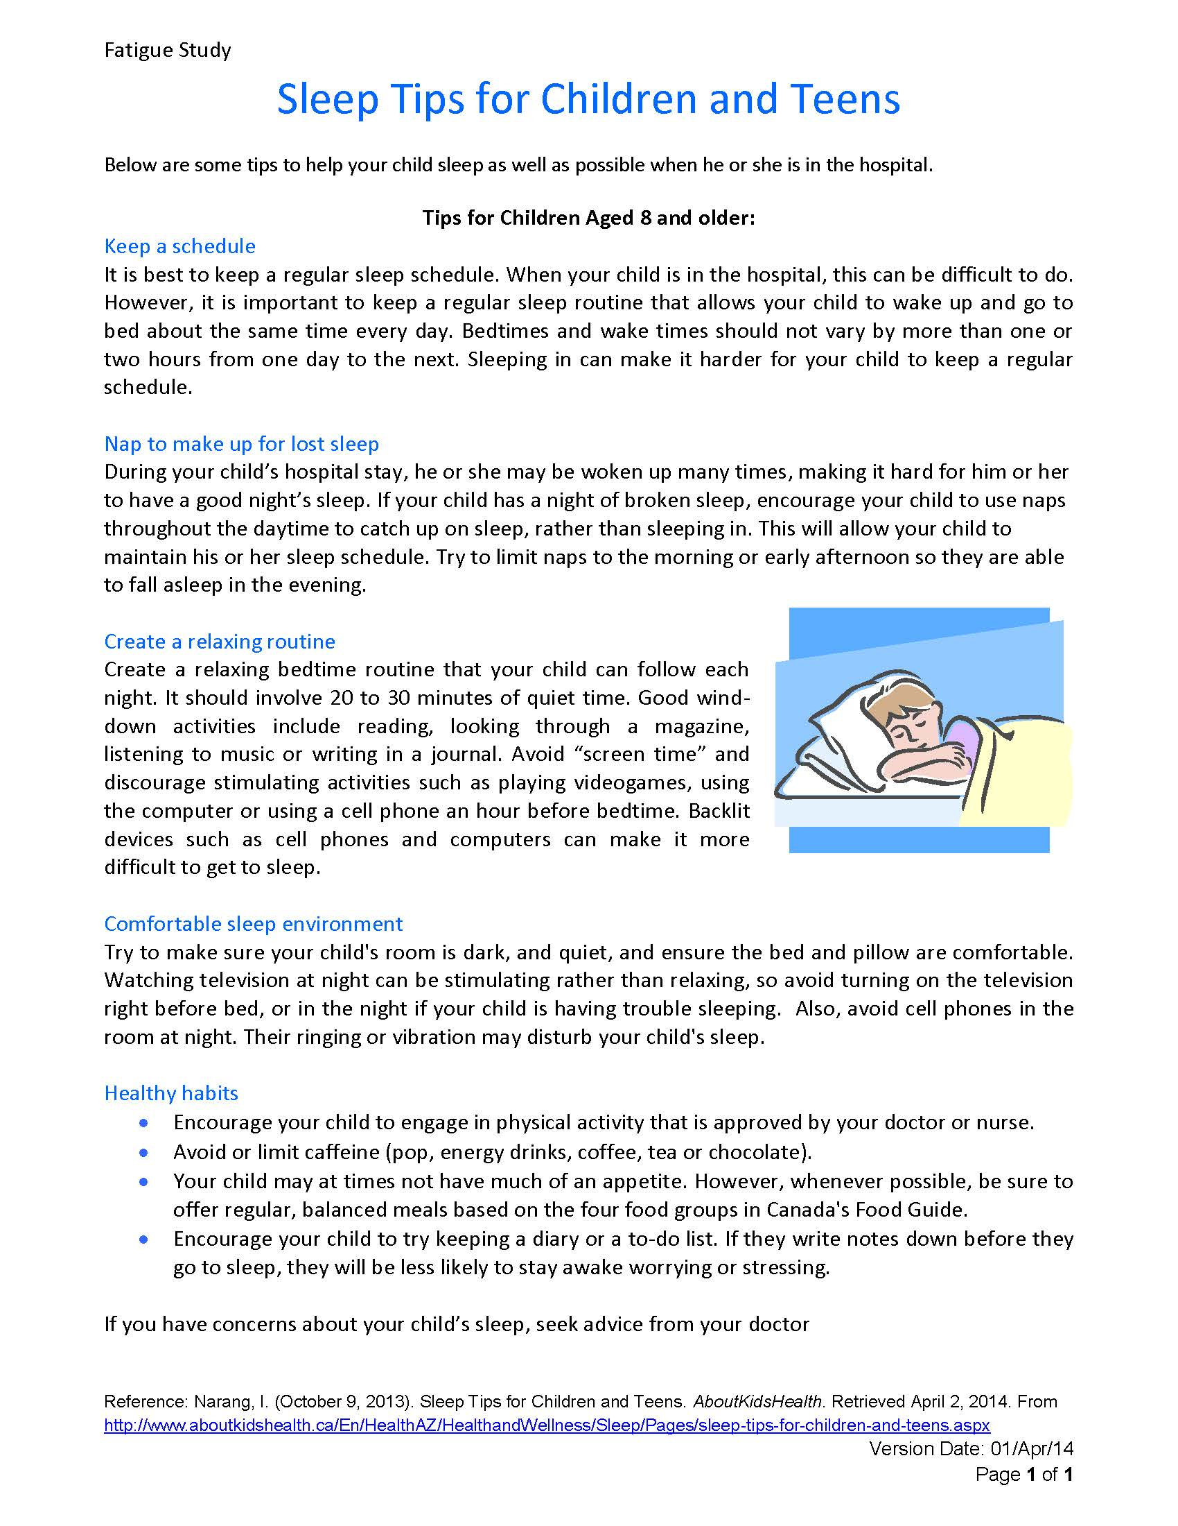
Version Date: 6Jul2021
Depression Care Pathway

