Slide 1
Version Date: 6Jul2021
Appetite Alteration Care Pathway
Prevention
Prevention
No standard approaches to prevention
Assessment
Assess nutritional status including growth parameters
Assess routinely using SSPedi
Assessment
Mild Bother
(SSPedi score = a little)
Moderate Bother
(SSPedi score = medium)
Severe Bother
(SSPedi score = a lot or extremely)
Allocate resources based on severity of bother and according to the preferences and capabilities of the patient
Treatment and Resources
Decreased Appetite
Encourage high calorie, nutrient-dense foods
Consult clinical nutrition services
Treatment
Suggest pharmacological agents not be routinely used
Increased Appetite
Encourage balanced diet
Consult clinical nutrition services

Slide 2
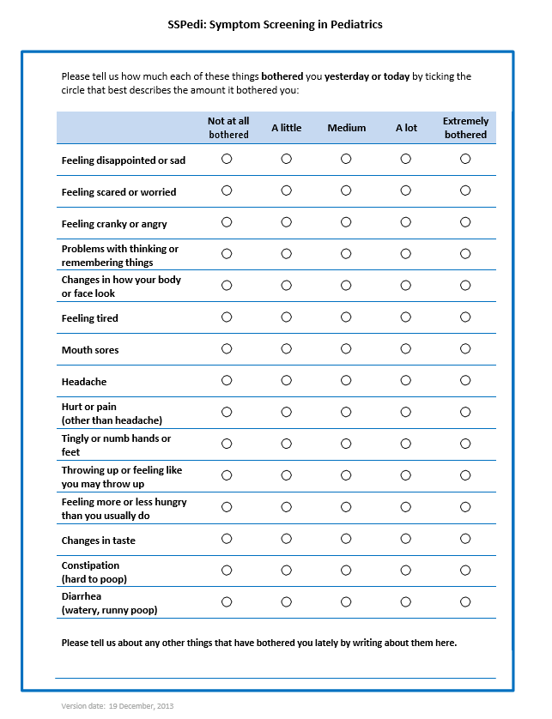
Version Date: 6Jul2021
Care Pathway

